Slide 1


Rating Prediction Project
Submitted by : Bhushan Kumar Sharma
Designation: Intern Data Scientist
Company : Flip Robo Technologies

Slide 2
Problem Statement
The rise in E-commerce has brought a significant rise in the importance of customer reviews. There are hundreds of review sites online and massive amounts of reviews for every product. Customers have changed their way of shopping and according to a recent survey, 70 percent of customers say that they use rating filters to filter out low rated items in their searches. The ability to successfully decide whether a review will be helpful to other customers and thus give the product more exposure is vital to companies that support these reviews, companies like Google, Amazon and Yelp.
There are two main methods to approach this problem. The first one is based on review text content analysis and uses the principles of natural language process (the NLP method). This method lacks the insights that can be drawn from the relationship between costumers and items. The second one is based on recommender systems, specifically on collaborative filtering, and focuses on the reviewer’s point of view.
We have a client who has a website where people write different reviews for technical products. Now they are adding a new feature to their website i.e. the reviewer will have to add stars (rating) as well with the review. The rating is out 5 stars and it only has 5 options available 1 star, 2 stars, 3 stars, 4 stars, 5 stars. Now they want to predict ratings for the reviews which were written in the past and they don’t have rating. So we, we have to build an application which can predict the rating by seeing the review.

Slide 3
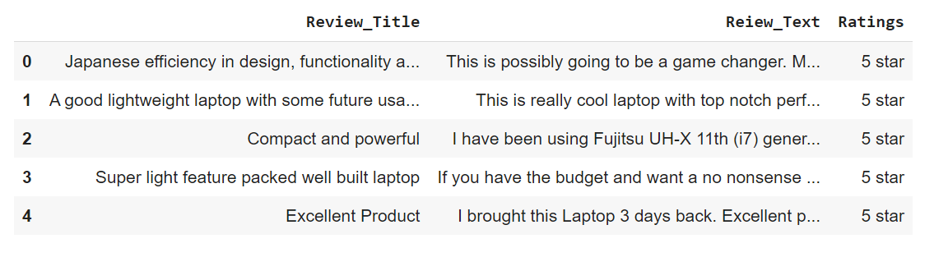
Scraped dataset
Two dataset has loaded one is for training and second is for to predict house prize

Slide 4
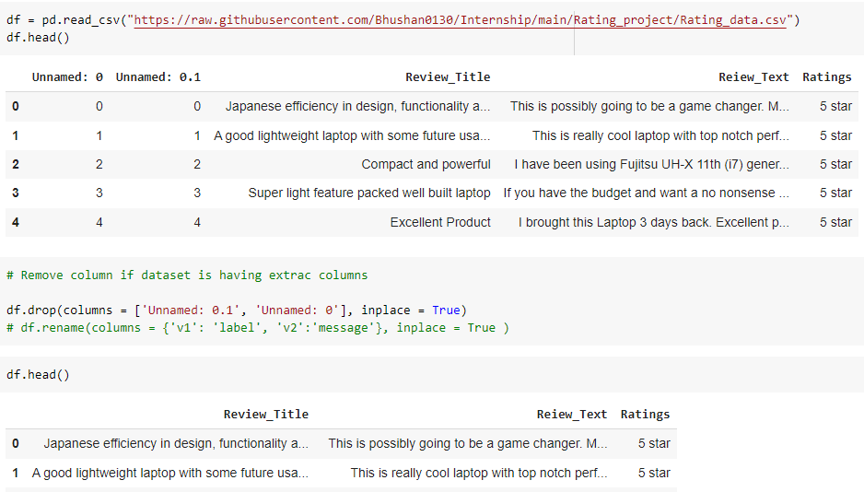
Loading Dataset
Two dataset has loaded one is for training and second is for to predict house prize

Slide 5
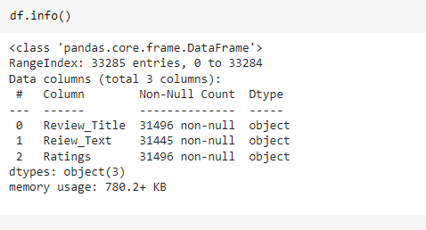
Information of dataset
Complete information one can see in this output of information

Slide 6
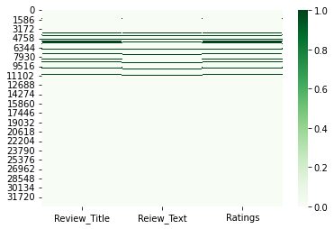
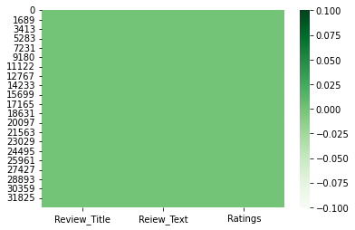
Checking null values
After
Before

Slide 7
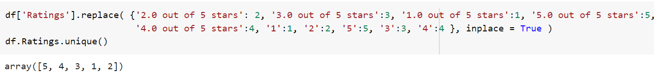
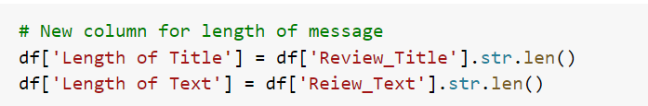
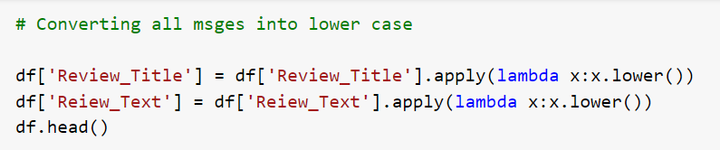
Data Preprocessing
Converted all target values into [5,4,3,2,1] class only:
Created new columns for length to get amount of cleaned data records
Converted all text into lower case:

Slide 8


Data Preprocessing
Replace email address with email:
Replace URL with Web address:
Replace money symbols with “moneysymb” £:

Slide 9


Data Preprocessing
Replace 10 digit phone numbers:
Replace numbers with “number”:
Remove punctuation:

Slide 10


Data Preprocessing
Replace whitespace between terms with a single space:
Remove leading and trailing whitespace

Slide 11
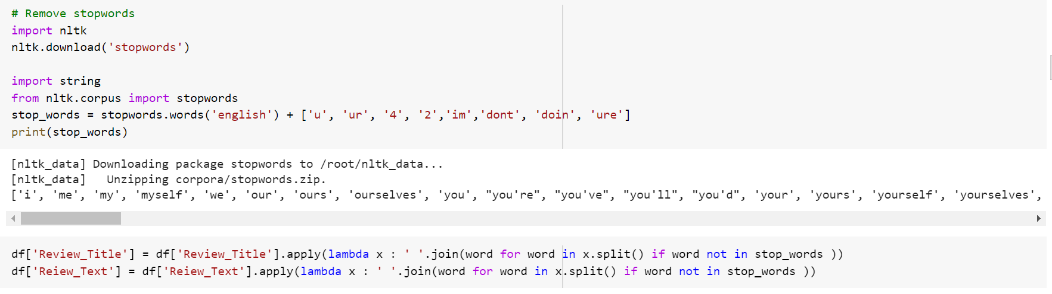
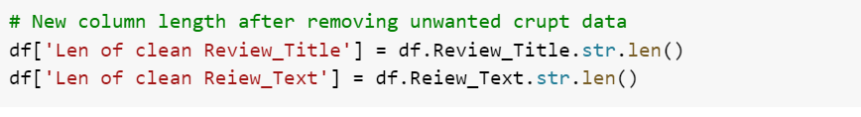
Data Preprocessing
Applied operation to remove stop words
By finding this Len of clean Review and Text we can see the content weightage, how much data have cleaned by processing various operation to convert into this desired form.

Slide 12
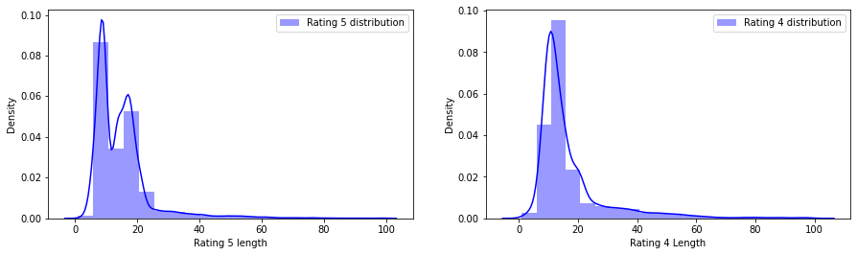
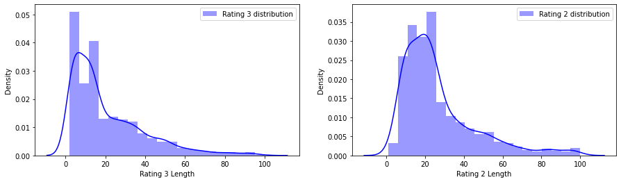
Visualization
Review text distribution before cleaning:

Slide 13
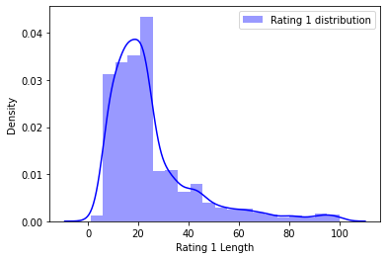
Visualization
Review text distribution before cleaning:

Slide 14
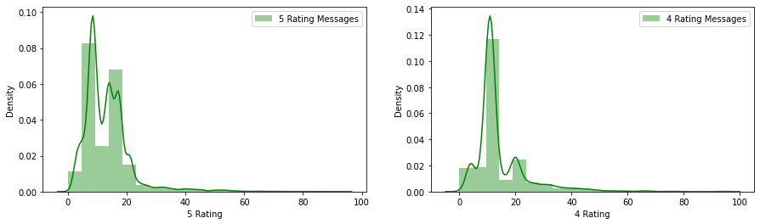
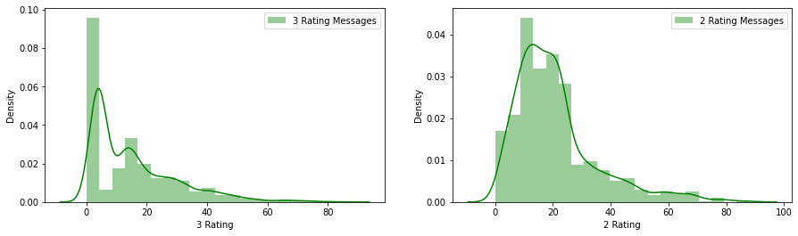
Visualization
Review text distribution After cleaning:

Slide 15
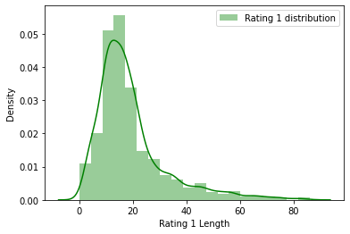
Visualization
Review text distribution After cleaning:

Slide 16
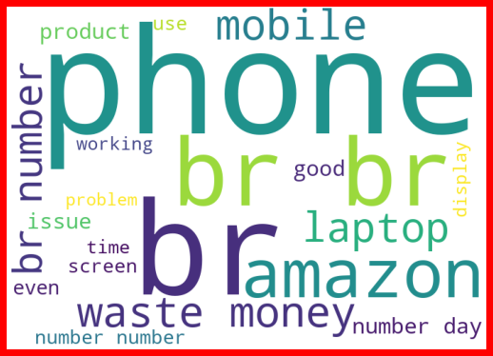
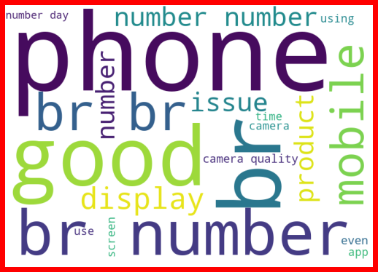
Visualization
Word Cloud:
1 Rating
2 Rating

Slide 17
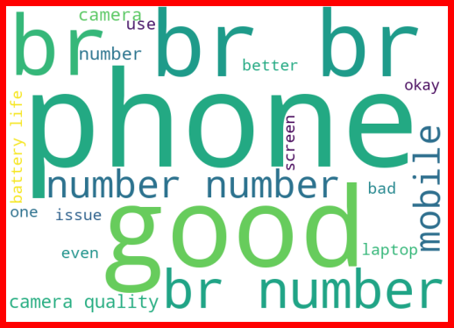
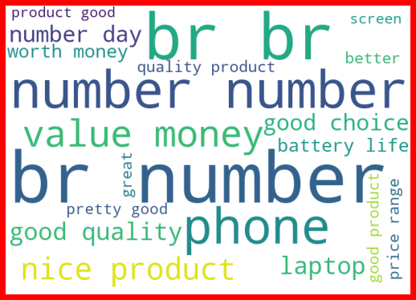
Visualization
Word Cloud:
3 Rating
4 Rating

Slide 18
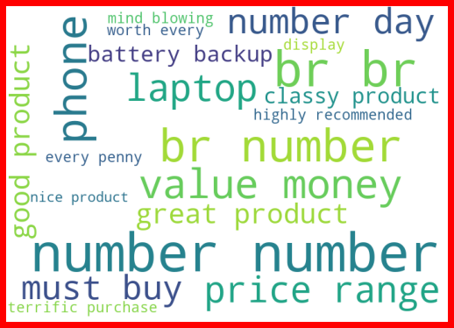
Visualization
Word Cloud:
5 Rating

Slide 19
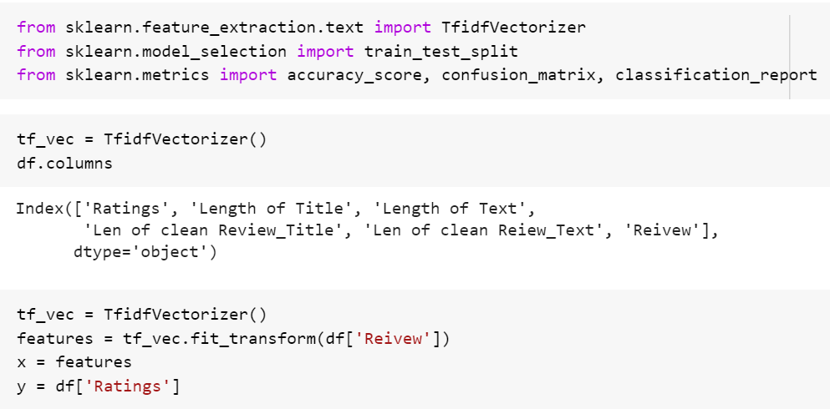
Separating data into x and y form
Apply TfidVectorizer to the Combined Review columns:

Slide 20
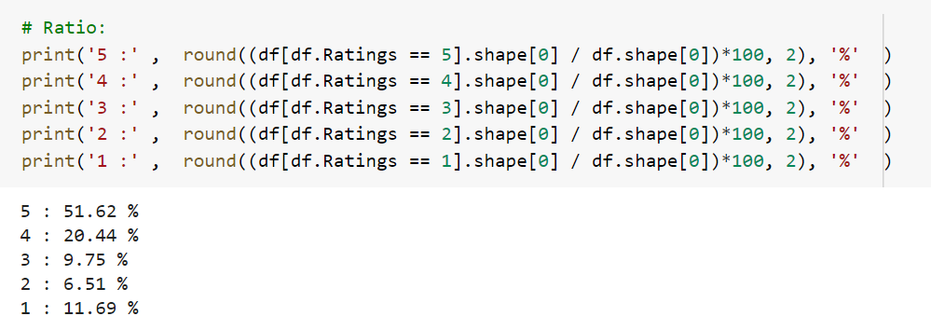
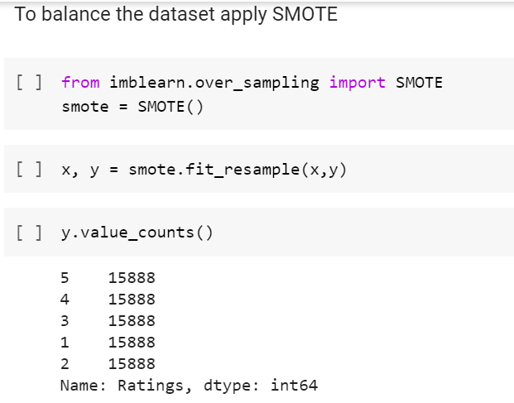
Balancing Dataset
Before
Before

Slide 21
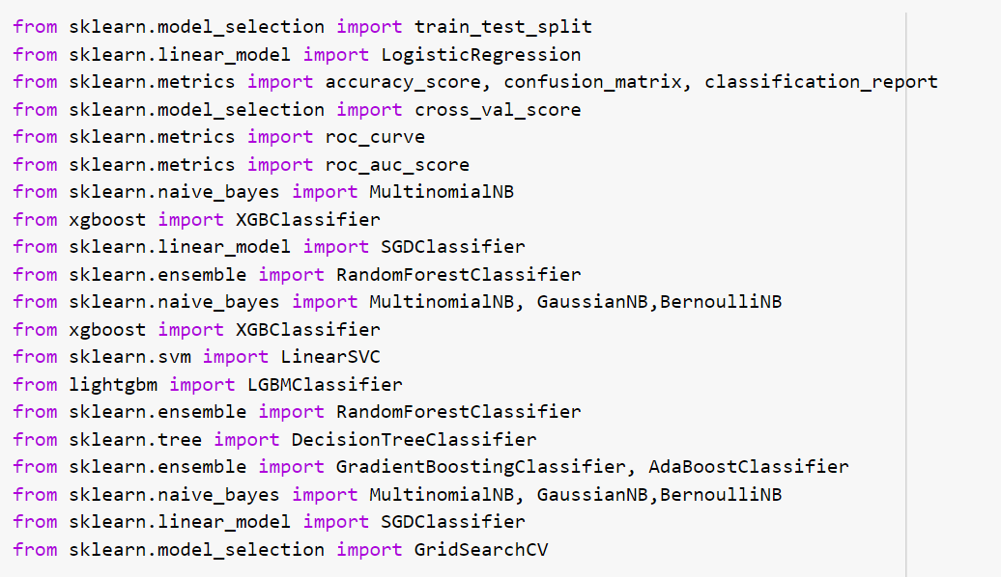
Machine learning
These libraries used for building model of machine learning

Slide 22
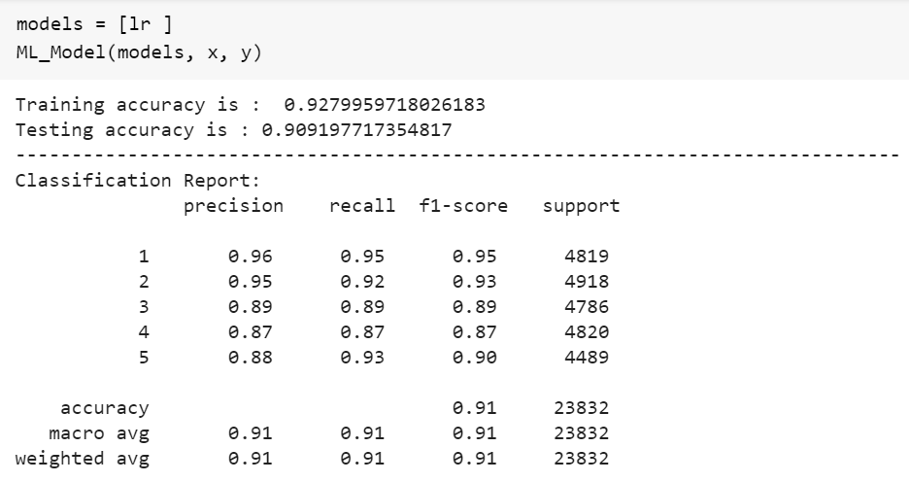
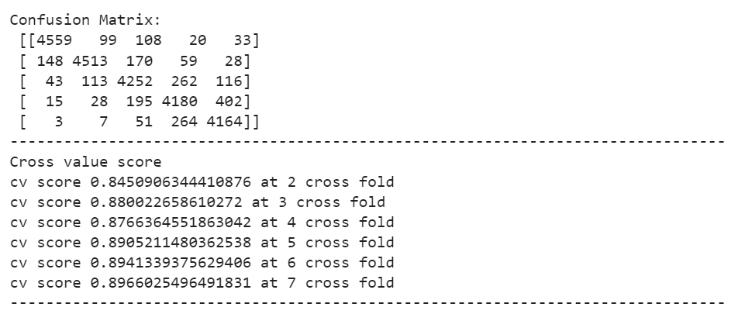
Logistic Regression model
This model is having very less accuracy of model and having very difference between cv and accuracy of model

Slide 23
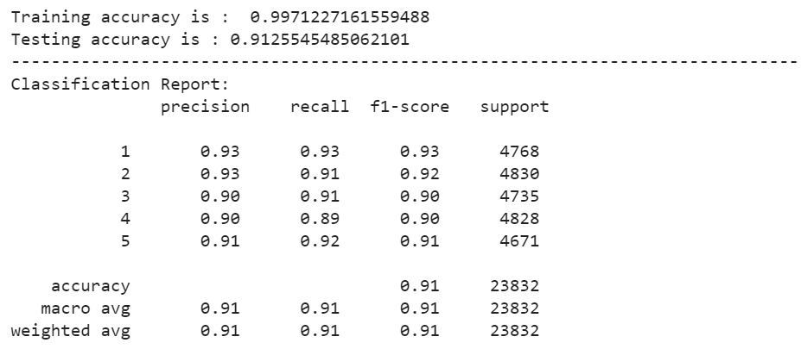
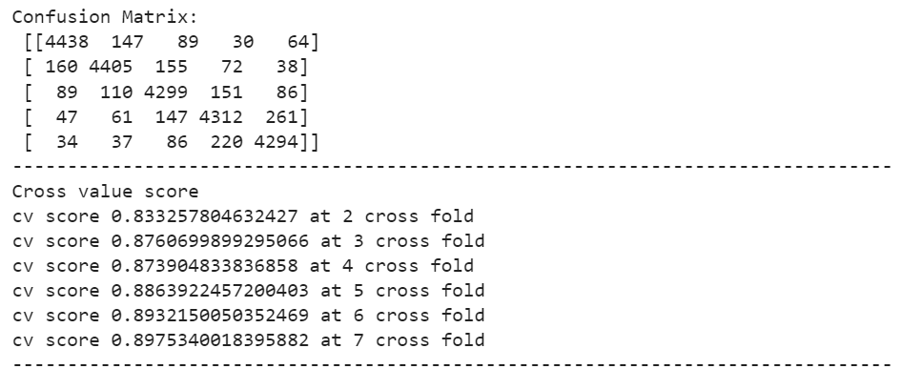
Decision Tree Classifiers Model
By applying this model, getting overfitted model, as its traing accuracy is higher than testing accuracy
Training Accuracy > Testing Accuracy

Slide 24
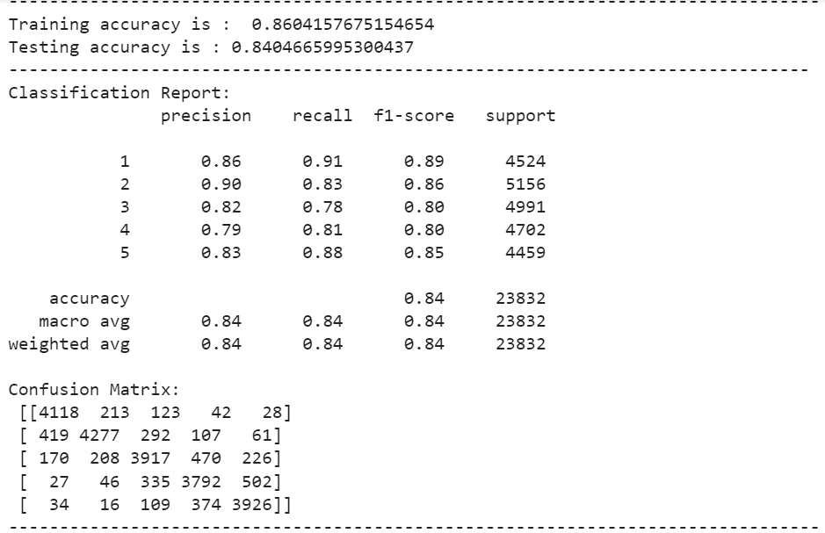
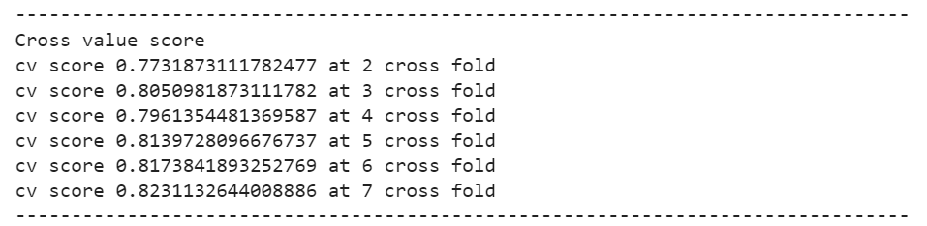
MultinomialNB Model
This model is also giving overfitted model, and also having very difference in cv score value and accuracy value

Slide 25
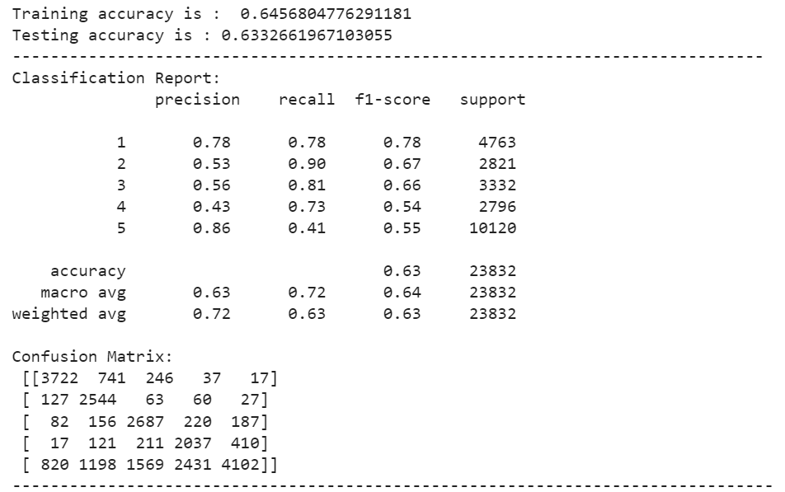
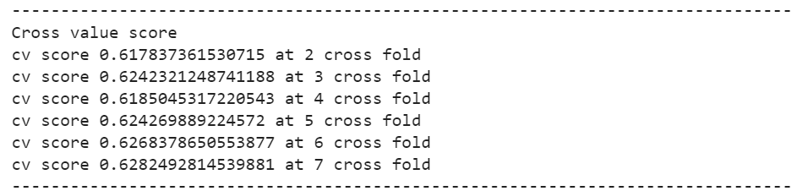
Bernouli Model
This model is also giving overfitted model, and also having very difference in cv score value and accuracy value

Slide 26
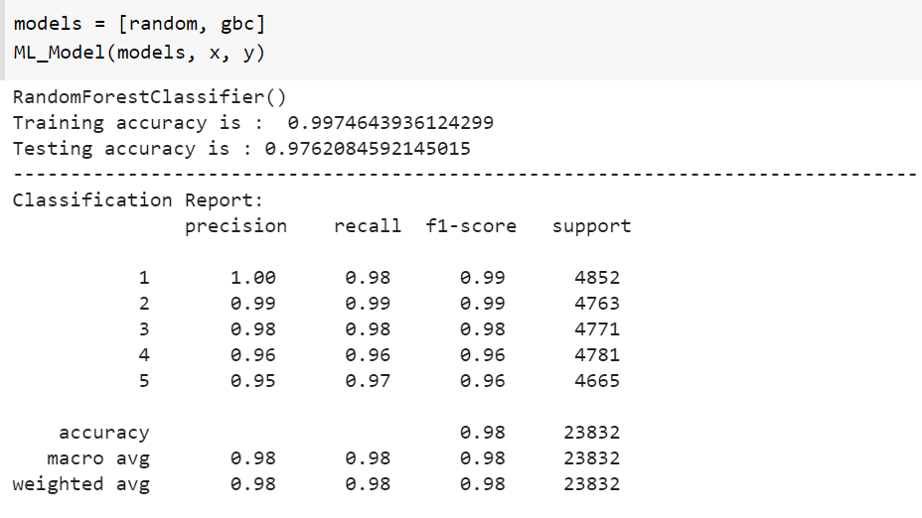
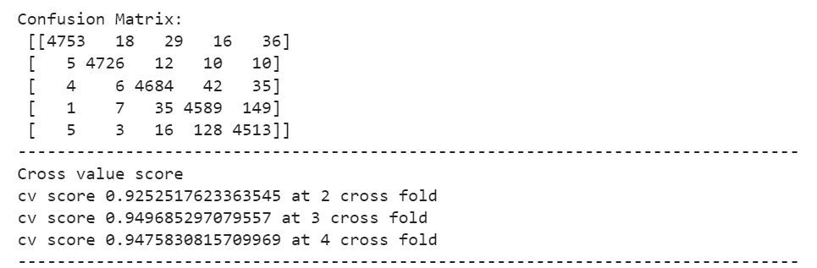
Applied Bagging and Boosting techniques
RandomForestClassifer:

Slide 27
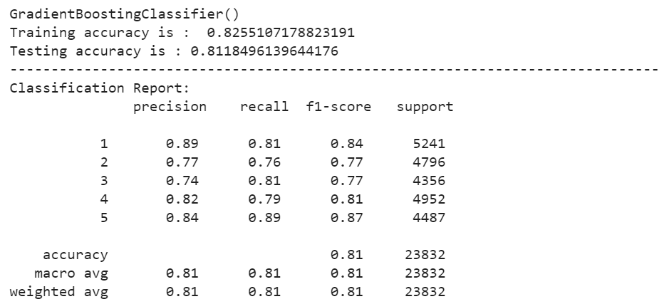
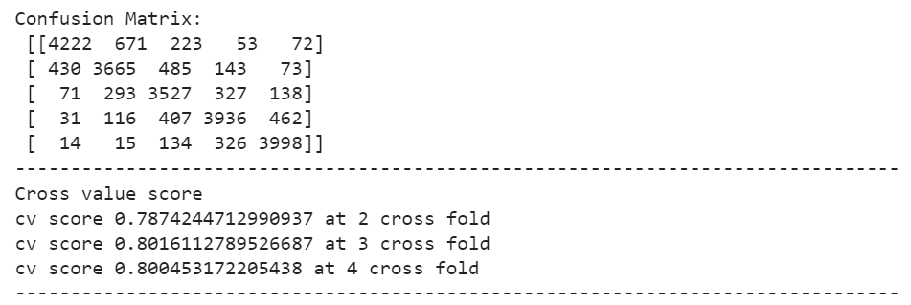
RandomForestClassifer:

Slide 28
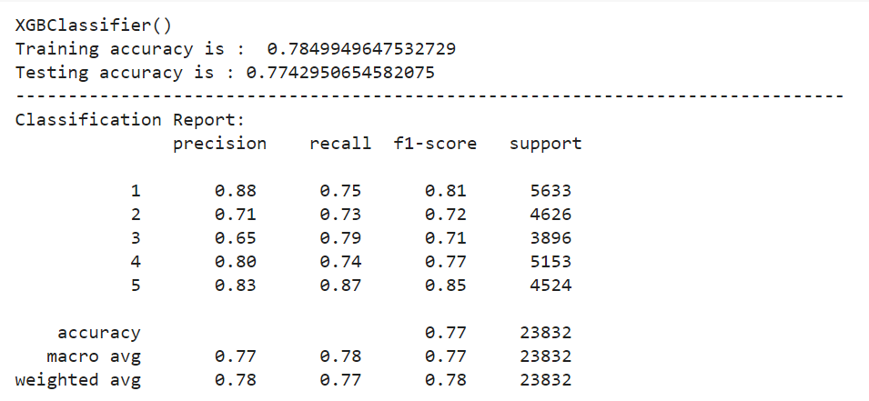
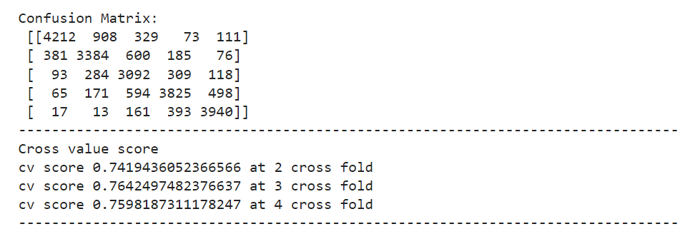
XGB Boosting:

Slide 29
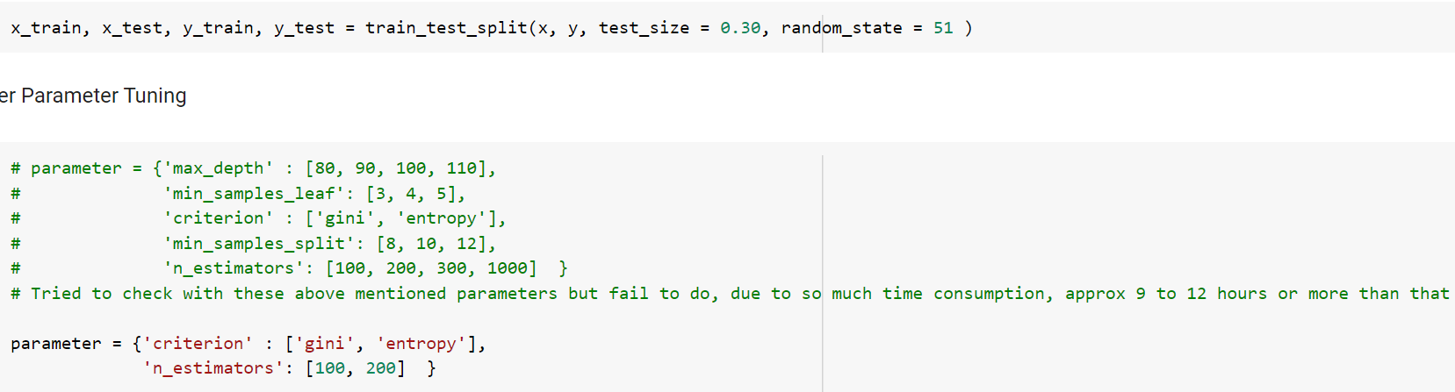
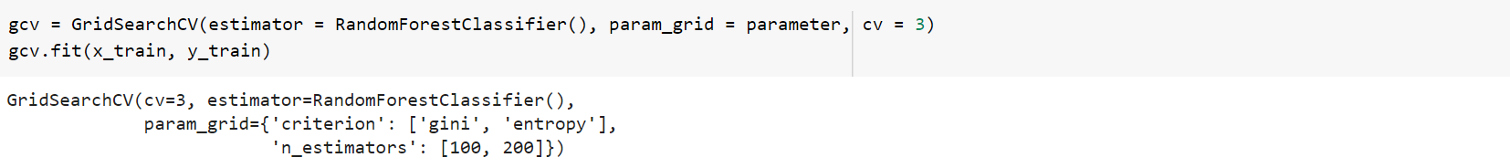
Ensemble Random Forest Classifier model

Slide 30
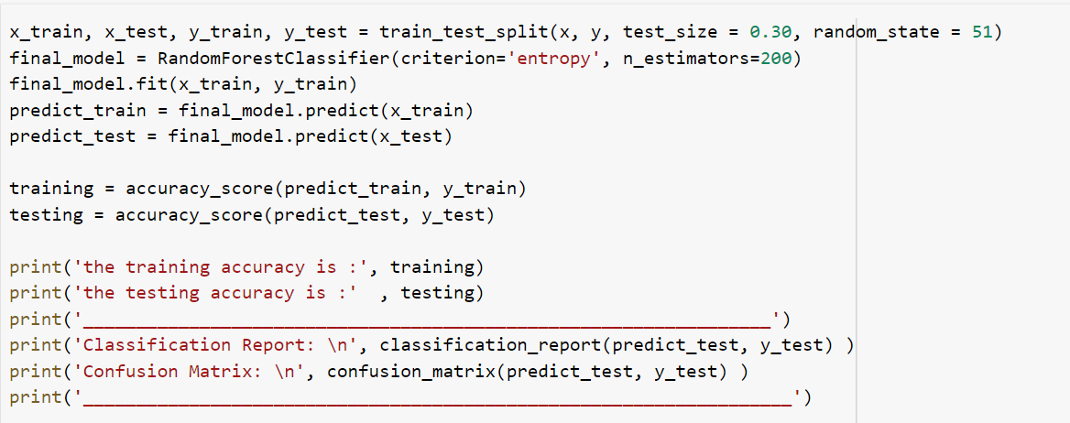
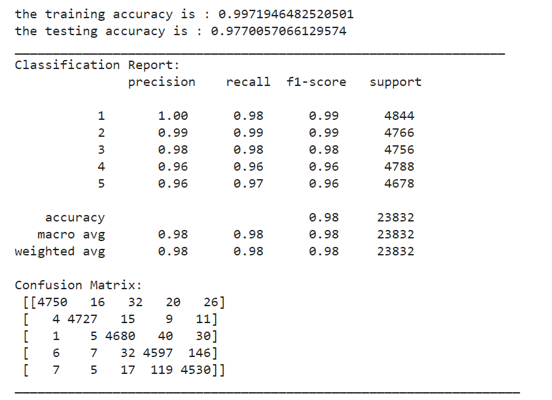
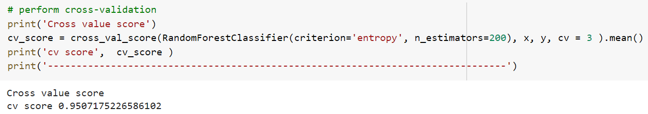
Final Model Performance:
jjjj

Slide 31
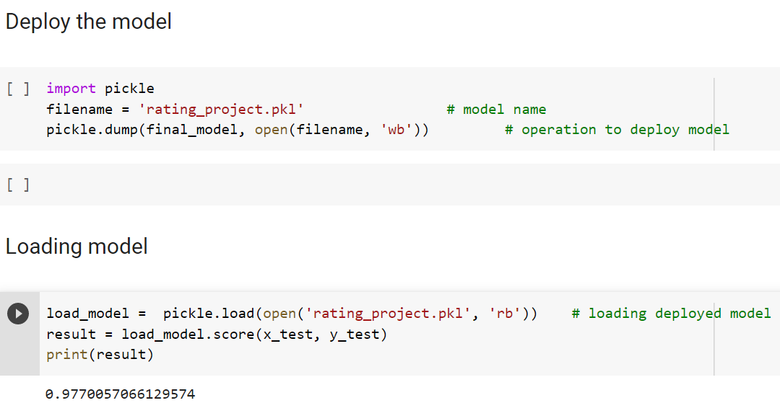

DEPLOY and load model:
Deployed

Slide 32
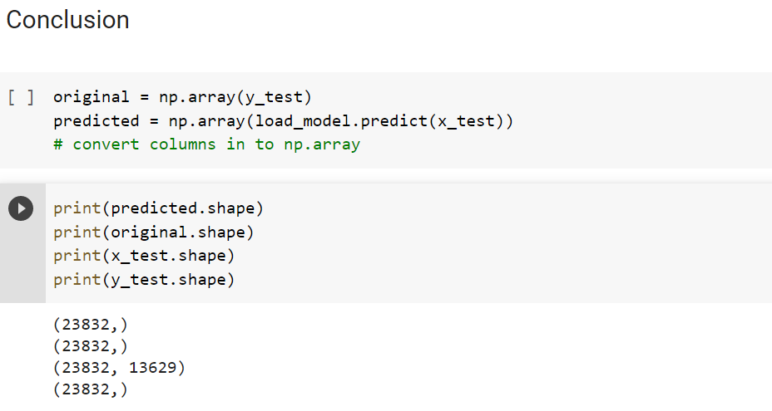
Conclusion:
One dataframe is created by the name

Slide 33
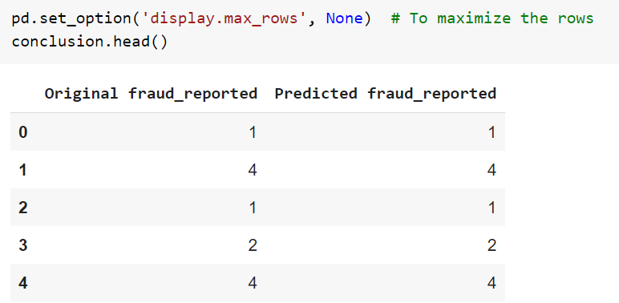
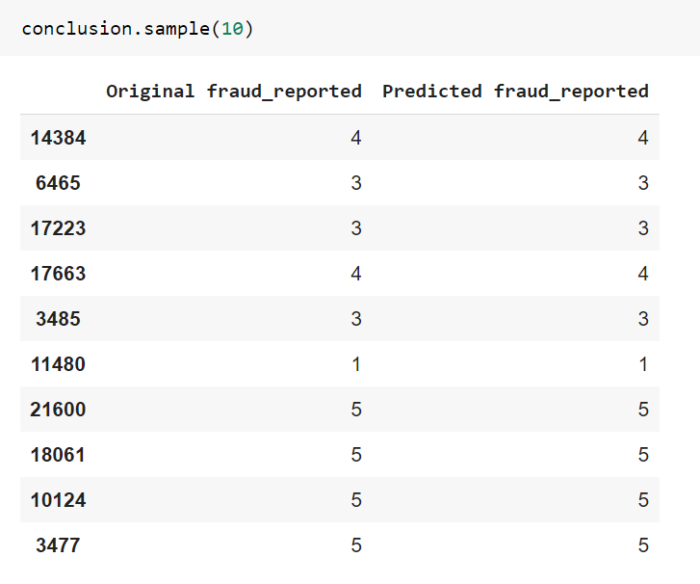
Conclusion:
One dataframe is created by the name

Slide 34
Thanks you

